Slide 1
Wow Technical Deliverable
ESG-651/Setting up AEL for Pentaho Spark integration
20-August-2019

Slide 2
Problem Statement
Running jobs in Pentaho for writing in hadoop give slow performance
POC – Reading a csv file from Mysql and finally storing in HDFS as a avro format file.

Slide 3
POC Tested
Adaptive Execution Layer–
Pentaho uses the Adaptive Execution Layer (AEL) for running transformations in different engines. AEL adapts steps from a transformation developed in PDI to native operators in the engine you select for your environment, such as Spark in a Hadoop cluster.
The AEL daemon builds a transformation definition in Spark, which moves execution directly to the cluster.
The installation of AEL daemon is done in the target system, and here we setup n our clusters. After we configure the AEL daemon, the PDI client communicates with both the Spark cluster and the AEL daemon, which lives on a node of our cluster to launch and run transformations.

Slide 4
Installation of Adaptive Execution Layer:
A HDFS folder was created and pdi-spark-driver.zip was generated from the Pentaho client .
Is assembled, installed, and configured on a Hadoop cluster.
Facilitates data transfer between any source and destination.
Utilizes installed system’s processing for better performance.
Converts all transformations into native functions on the fly when job is executed.
AEL deamon is started using the command :
sh /mapr/MapRDev/user/AEL/data-integration/adaptive-execution/daemon.sh start

Slide 5
application.properties
websocketURL | ws://hadoop-c02n06.ss.sw.ericsson.se:${ael.unencrypted.port}
sparkHome | /opt/mapr/spark/spark-2.2.1
sparkApp | /mapr/MapRDev/user/AEL/data-integration/
hadoopConfDir | /opt/mapr/hadoop/hadoop-2.7.0/etc/hadoop
hadoopUser | mapradm
sparkMaster | yarn
assemblyZip | maprfs:///user/AEL/pdi-spark-executor.zip
assemblyZip | hybrid
Djava.security.auth.login.config | /opt/mapr/conf/mapr.login.conf

Slide 6
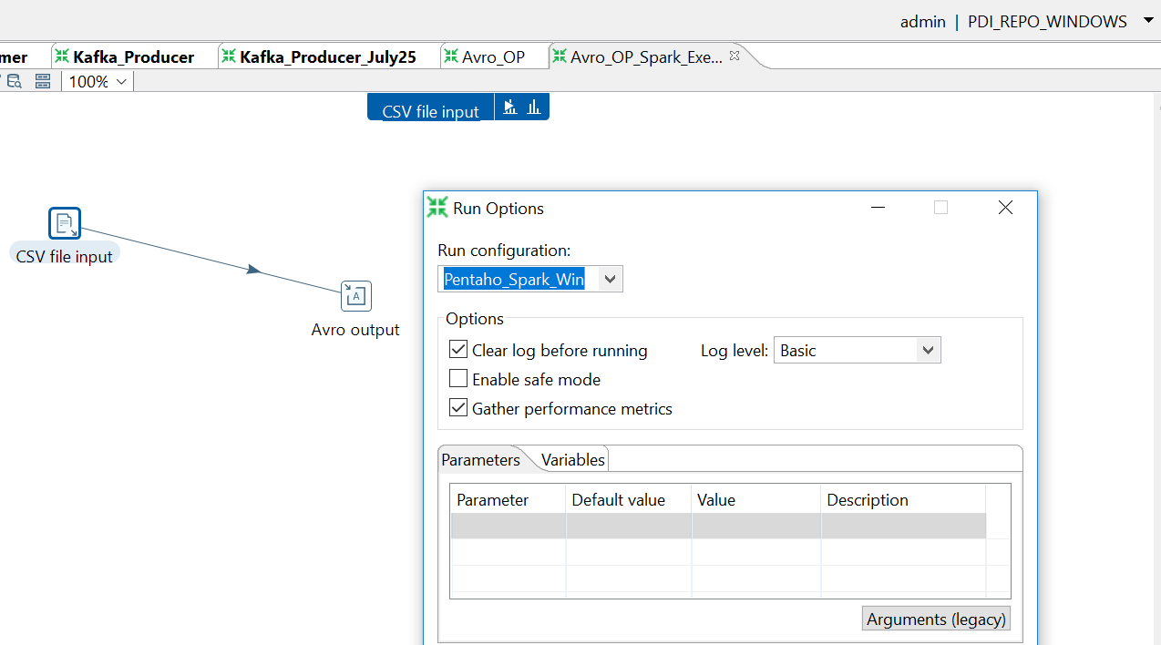
POC Tested:
The csv file from the source system

Slide 7
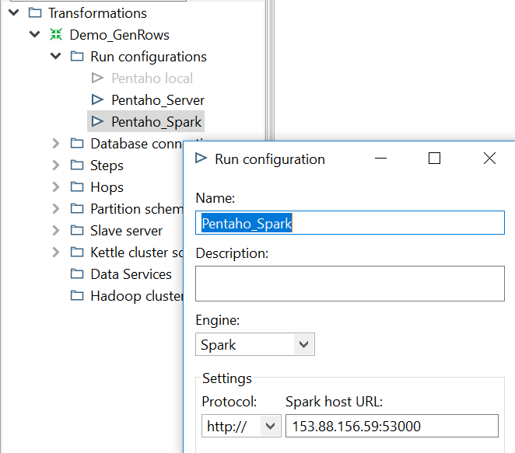
The selection of the running environment while executing the job

Slide 8
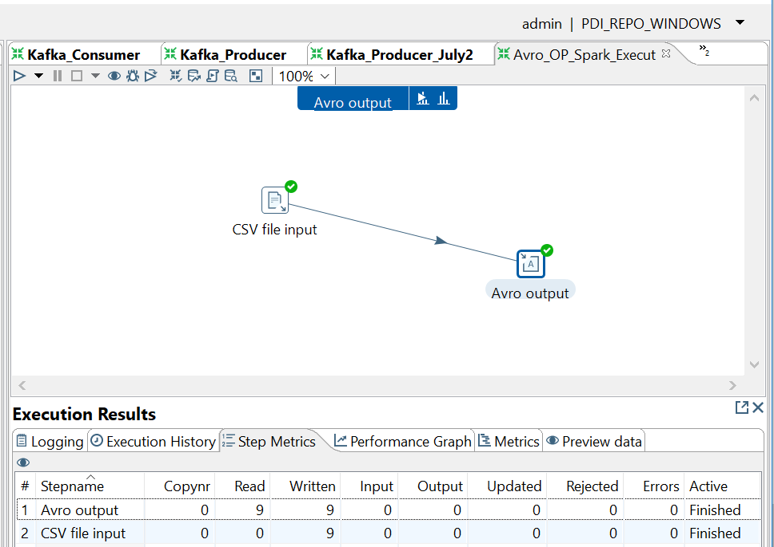
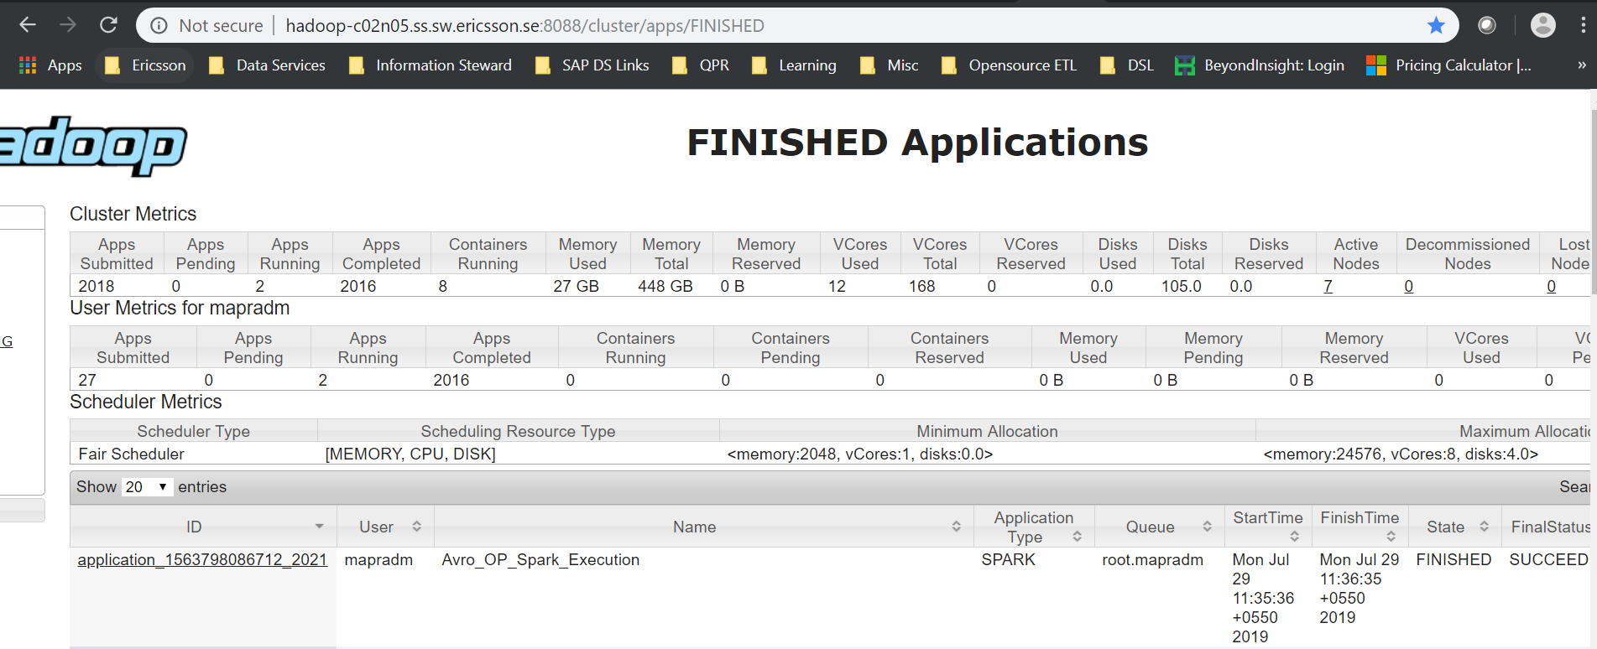
The job of copying csv from Mysql to avro file in HDFS

Slide 9
"
THANK YOU

